Slide 1
Reinforcement learning

Slide 2
Outline
1. Introduction RL
2. Markov decision process (MDP)
3. Policy and value function
4. Q-learning and SARSA
5. Deep reinforcement learning
6. Implement coding

Slide 3

1. Introduction RL
- About RL: Learning by reinforcement combines two tasks.
+ The first is exploring new situations.
+ The second is using that experience to make better decisions. Given time, this results in a plan to achieve a task
- A child learns to walk, after standing up, by leaning forward and falling

Slide 4
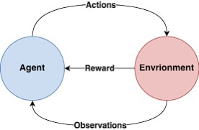
What is RL ?
Reinforcement learning (RL) is a subfield of machine learning (ML) that addresses the problem of the automatic learning of optimal decisions over time. This is a general and common problem that has been studied in many scientific and engineering fields.
Reinforcement learning (RL) tells you how to make the best decisions, sequentially, within a context, to maximize a real-life measure of success.
The decision-making entity learns this through trial and error. It is not told which decisions to make, but instead it must learn by itself, by trying them

Slide 5
RL formalisms
Agent: the learner or decision-maker that interacts with the environment to achieve a goal.
Environment: everything outside the agent that agent interact with.
Actions: The choices the agent can make to influence the environment.
States: the current situation or condition of the agent within the environment.
Reward: feedback received by the agent to indicate the success or failure of an action.
Imagine you are training your dog to perform basic commands, such as "sit," "lie down," or "fetch a ball." Initially, the dog doesn’t understand what you want it to do. However, with patience and a reward-based system, you can teach it these actions.

Slide 6
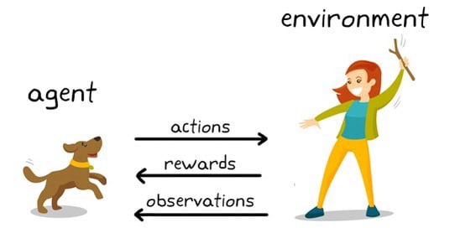
For example: Dog training
Agent: The dog being trained.
Role: The dog acts as the agent, making decisions (actions) based on the current state to maximize the rewards it receives.

Slide 7
For example: Dog training
Environment: The surroundings where the dog is being trained, including the trainer and other objects around.
Role: The environment provides feedback to the agent (the dog) through rewards or negative signals.

Slide 8
For example: Dog training
Actions: The choices the dog can make. Examples:
Sitting.
Lying down.
Barking.
Running towards the trainer.
Not responding (wrong action).
Role: The dog selects an action in response to a cue or command from the trainer.

Slide 9
For example: Dog training
States: The current situation the dog is experiencing. Examples:
Whether the dog is sitting, lying, or standing.
The trainer holding a reward or giving a command.
The position of the trainer and objects.
Role: The dog observes the state to decide its next action.

Slide 10
For example: Dog training
Rewards: Positive or negative feedback the dog receives after performing an action. Examples:
+10: When the dog performs correctly (e.g., sits when commanded) → receives a treat or praise.
-5: When the dog performs incorrectly (e.g., barks unnecessarily) → no reward or is ignored.
+20: When the dog repeatedly performs the correct action.
Role: Rewards help the dog understand which actions are beneficial to repeat in the future.

Slide 11
When should use RL ?
1. When Optimizing Sequential Decisions:
- Reinforcement Learning (RL) is well-suited when actions are not independent but influence future states. - Example: In robotics, the goal of a robot is to perform tasks that are not predefined, such as learning to walk or picking up objects.
2. When Optimizing for Long-term Rewards:
- RL focuses not only on immediate rewards but also considers long-term benefits. - Example: In advertising, RL systems optimize the click-through rate (CTR) across multiple ads.
3. When Rapid, Online Learning is Required:
- RL is effective in environments that demand quick learning and decision-making in real time. - Example: In A/B testing based on profit, RL can quickly learn how to optimize performance in real-time.

Slide 12

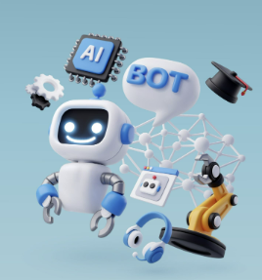

RL applications
Robotics: RL is used to enhance the movements and skills of robots, such as playing ball, maintaining balance, or flipping pancakes.
Autonomous Vehicles: RL helps self-driving cars learn to navigate safely and efficiently in real-world environments.
Cloud Computing: Automates autoscaling to optimize latency and resource utilization.
Finance: Applies RL for automated trading or portfolio allocation.
Energy Management: Optimizes energy usage in buildings by adjusting lighting, heating, etc.
Traffic Control: Improves traffic light management or lane allocation to reduce congestion.
Healthcare: Uses RL for scheduling doses and personalizing treatment plans.
Education: Develops personalized learning programs based on RL to enhance learning outcomes.

Slide 13
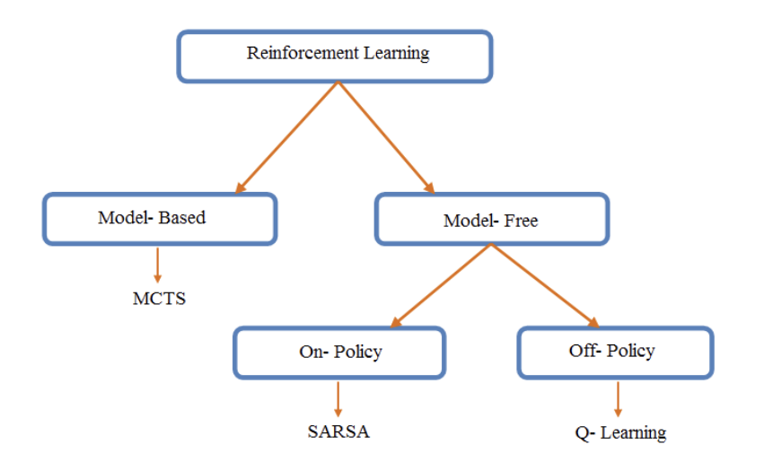
Type of RL algorithms
Reinforcement Learning (RL) can be broadly classified into two main categories based on how the algorithm interacts with the environment: Model-Based and Model-Free
Model – based algorithms use definitive knowledge of the environment they are operating in to improve learning.
-For example, board games often limit the moves that you can make, and you can use this knowledge to (a) constrain the algorithm so that it does not provide invalid actions and (b) improve performance by projecting forward in time
-Human-beating algorithms for games like Go and poker can take advantage of the game’s fixed rules
Model – free algorithms can, in theory, apply to any problem. They learn strategy through interaction, absorbing any environmental rules in the process.

Slide 14
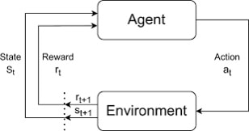

2. Markov decision process ( MDP )
The agent can never fully appreciate the environment. The agent receives a limited set of observations that represent the current state of the system
The agent and environment interact in a sequence of discrete time steps, t. At each time step the agent receives a representation of the state, s. Based upon the state of the environment the agent can suggest an action, a, and one time step later receives a value representing the reward, r, and a new set of states, s′.
The states and rewards are random variables
The transition model is the probability of landing in a new state with a reward given a previous state and performed action

Slide 15
Markov decision process
MDP consists of the following components:
S: The set of states.
A: The set of actions.
P(s′∣s,a): The transition probability from state s to state s′ after taking action a.
R(s,a,s′): The reward received when transitioning from state s to state s′ by taking action a.
γ: The discount factor (0≤γ≤1), representing the importance of future rewards.

Slide 16
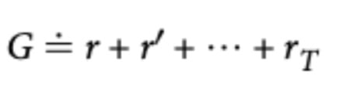
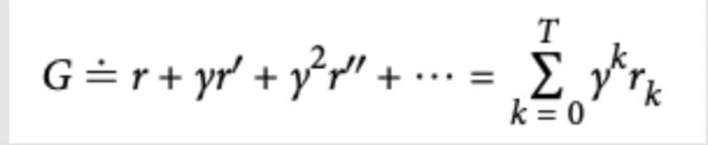
3. Policy and value function
A policy is a mapping from states to potential actions
Discounted reward:
The return, G, is the total reward from this current step up to the final time step
To mitigate against the explosive power of infinity, we adds a discounting factor that exponentially reduces future rewards
γ is called the discount rate or factor. It controls how soon future rewards are ignored and should be a value between 0 and 1

Slide 17
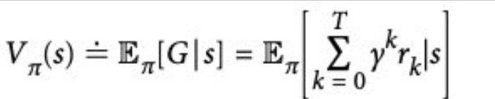

State value - V
Definition:
The state value Vπ(s)is the expected total reward when starting from state s and following policy π
Bellman formula:

Slide 18
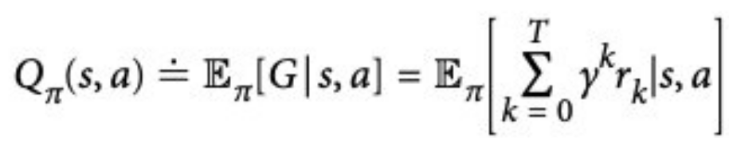
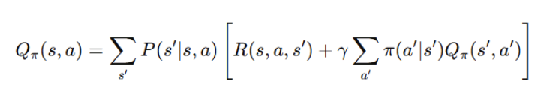
Action value - Q
Definition:
The action value Qπ(s,a) is the expected total reward when starting from state s, taking action a, and then following policy π.
Bellman formula:

Slide 19



Optimal policy
Optimal Policy (π∗): The policy that enables the agent to achieve the maximum possible cumulative rewards. With the optimal policy, the value of each state or action reaches its optimal value:
Bellman formula:
At each state-action pair (s,a), the optimal value is computed as the immediate reward plus the discounted optimal value of the next state s′.

Slide 20


Temporal difference - TD
Temporal Difference (TD) is a crucial method in Reinforcement Learning (RL) used to estimate state or action values through experience. TD combines the advantages of:
Monte Carlo Methods: Learning from actual experiences.
Dynamic Programming: Using update formulas based on the Bellman equation.
Key features of TD:
Learns without requiring prior knowledge of the environment's model (i.e., no need for P(s′∣s,a)).
Updates value estimates after every step instead of waiting for a complete episode.

Slide 21
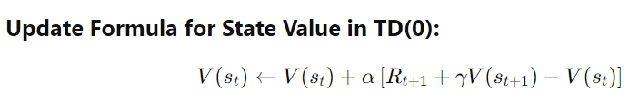
TD for state value
Temporal Difference (TD) for state value uses real experiences to update the value of a state V(s) step by step, based on immediate rewards and the predicted value of the next state.

Slide 22
4. Q-learning and SARSA

Slide 23
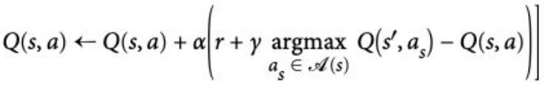
Q-learning
Q-learning is a popular model-free reinforcement learning algorithm. It falls under the category of temporal difference learning techniques, in which an agent picks up new information by observing results, interacting with the environment, and getting feedback in the form of rewards.
Example: Scenario: Robot learns to navigate through a maze to find treasure. The robot starts at a corner of the maze, the current state is 𝑠. It can move in directions (left, right, up, down), called actions a.
For each move, the robot receives:
r=−1: Go wrong or go into a wall.
r=+100: Reach the treasure.
The robot updates the Q-value for each action based on the above formula and continues testing until it learns the optimal route.

Slide 24
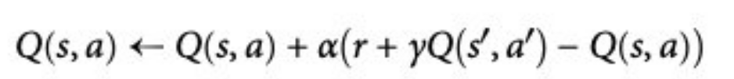

SARSA
SARSA was developed shortly after Q-learning to provide a more general solution to TD learning. The main diference from Q-learning is the lack of argmax in the delta. Instead it calculates the expected return by averaging over all runs
For example: Scenario: A robot learns to walk across a wooden bridge where it may fall.
If the robot chooses the slow (safe) path, it has a better chance of reaching its destination safely (but takes longer).
If it chooses the fast (risky) path, it may get a higher score but risks falling.
SARSA will prioritize the safer action, because it learns based on real-life experience rather than theoretical values.

Slide 25
Compare Q-learning and SARSA
Criteria | Q-learning | SARSA
Algorithm type | Off-policy | On-policy
Key feature | Learns the Q-value by assuming the best action (greedy) is always chosen. | Learns the Q-value based on the actual action taken.
Action selection for next step | Based on the optimal policy (e.g., selecting max(Q(s', a'))). | Based on the current policy (e.g., epsilon-greedy with Q(s', a')).
Stability and safety | Prone to oscillations in unstable or noisy environments. | More stable, suitable for complex or dynamic environments.
Applications | - Optimization-focused tasks, aiming for the highest performance. - Simple, low-noise problems. | - Robotic control, where safe actions are a priority. - Complex and dynamic environments.
When to use | When the goal is to find the optimal policy regardless of the current actions. | When stability and adherence to policy constraints are crucial.

Slide 26

Extensions to Q-Learning
Double Q-Learning
-The first time the agent receives a positive reward, it will update the action-value estimate. Subsequent episodes will repeatedly choose the same set of actions. This could create a loop where the agent keeps making sub- optimal decisions, because of that initial bad update
-To solve this problem is by using two action-value functions, in other words, two lookup tables. The agent then uses one to update the other and vice versa. This produces an unbiased estimate of Q s, a
Delayed Q-Learning
-Rather than update the action-value function every time the agent visits that state- action pair, it buffers the rewards. Once the agent has visited a certain number of times, it then updates the main action-value function
N-step algorithms
-The essence of the idea is to extend one of the TD implementations, for example, to iterate over any number of future states

Slide 27
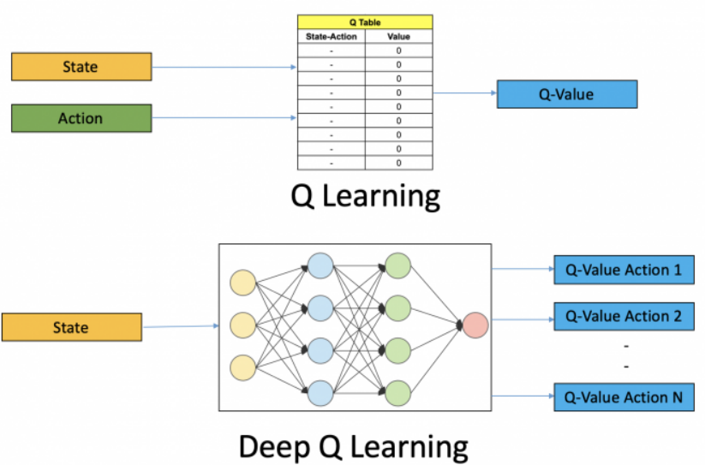
5. Deep reinforcement learning
- The reason for the development of Deep Q -learning: Deep Q-learning was developed to address the issue of traditional Q-learning in environments with large or continuous state spaces, where the Q-table cannot store all the state values.
- Using neural networks to approximate the Q -function:
+Deep Q-learning replaces the Q-table with a deep neural network (Deep Neural Network) to approximate the value Q(s,a) for state-action pairs.
+The neural network is capable of handling large and continuous state spaces, learning from the data collected during interactions with the environment.

Slide 28
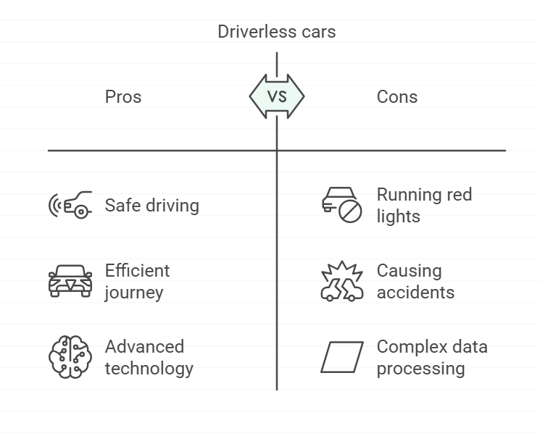
5. Deep reinforcement learning
Example: Driverless cars:
- Description: Driverless cars learn to drive safely, avoiding collisions.
- Application:
+State: Data from sensors (camera, lidar, GPS).
+Action: Accelerate/decelerate, turn left/right.
- Reward:
+100: Complete the journey without collision.
-50: Run a red light.
-200: Cause an accident.
Neural networks process large amounts of data from sensors to help the car learn the optimal driving policy.

Slide 29

Structure and process of Deep Q-learning
Deep Q-Learning (DQN) is an improvement of the traditional Q-Learning algorithm, using a deep neural network (DNN) to approximate the value of Q(s,a) in problems with large or continuous state spaces. This helps overcome the limitations of using Q tables in traditional Q-Learning.
•The biggest problem in using approximation is the convergance:
•Model optimizers like stochastic gradient descent assume that your data is independent and identically distributed (IID) random variables
•The definition of the MDP says that the next observation is dependent on the previous state and the action taken. This violates the IID assumption and models can fail to converge
•The solution is to use Experience Replay and Q-Network clones
•The Experence Replay is a buffer of observations, actions, rewards, and subsequent observations that can be used to train the DL model by taking a random subset
•Q-Network clones: In an update to the original DQN algorithm, the same researchers proposed cloning the Q-network. This leads to two NNs: one online network that produces actions and one target network that continues to learn
•How to choose action in DQN:
•Q represents the function used to predict the action values from the NN and θ represents the parameters of the function

Slide 30
Structure and process of Deep Q-learning
Deep Q-Learning (DQN) example: Self-driving car
Problem: Self-driving car moves from point A to point B in the test site, avoiding obstacles and optimizing time.
Structure:
- State: Vehicle position, distance to obstacles and destination.
- Actions: Accelerate, decelerate, turn left/right.
- Rewards: +10 when approaching the destination, -100 if there is a collision, +50 when reaching the destination, -1 each step to encourage route optimization.
- Process: The car uses Replay Buffer to save experience, Target Network to stabilize learning, and Q-Network to estimate the optimal action value.
- Result: The car learns to avoid obstacles, find the shortest path and achieve high efficiency after training.
Application: Developing self-driving cars in the city, robots moving in factories.

Slide 31

6. Implement coding

Slide 32
Thank you!

Slide 33
Compare RL and SL( supervised learning )
Criteria | Reinforcement Learning (RL) | Supervised Learning (SL)
Objective | Learn to optimize actions to maximize long-term rewards. | Learn from labeled data to predict outputs from inputs.
Input Data | Interaction with the environment, no explicit labels, but rewards/penalties. | Clearly labeled data (input-output pairs).
Learning Mechanism | Based on trial-and-error and feedback from the environment (rewards/penalties). | Learn by minimizing the error between predictions and true labels.
Reward/Penalty System | Relies on a reward/penalty system to evaluate actions. | No reward/penalty system, only prediction error.
Training Method | Learning through episodes of experimentation and optimizing a policy. | Learning by training on input-output pairs.
Common Applications | Games, robotics, supply chain optimization, autonomous control. | Classification, regression, image recognition, text prediction.
Data Independence | Depends on the current state of the environment. | Independent of state or time, as long as data is relevant.
Temporal Continuity | Actions may depend on a sequence of events over time. | Usually independent across samples (i.i.d. - independent and identically distributed).
Computational Complexity | Higher, as it requires interaction with the environment and multi-step optimization. | Lower, mostly involves processing static data.
Uncertainty | Often deals with uncertain and dynamic environments. | Uncertainty mainly lies in the labeled data.

